Slide 1

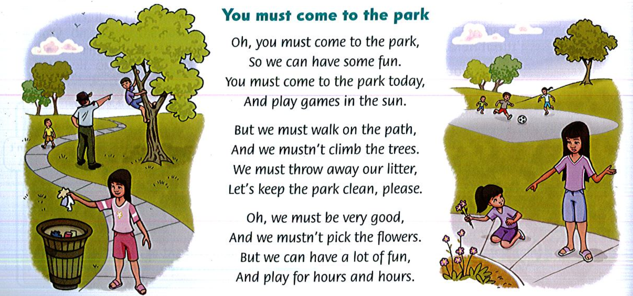
Tuesday , April 28th, 2020.
Unit 10: (Cont.)
Lesson 3: Grammar and Sing
Grammar: https://www.youtube.com/watch?v=eitaIAgQ0hA
Listen and sing:
Sing and do:

